Slide 1
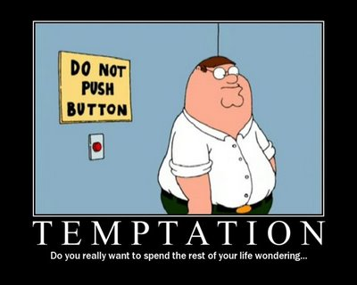

Slide 2

Let’s all go to the movies!
Notes:
http://www.youtube.com/watch?v=QX_oy9614HQ The marshmallow test
Little kids given a choice
If you don’t eat the marshmallow until I get back, you get 2 marshmallows
Kids who resist temptation are more successful in later life
Pass out Marshmallows to each kid and give them the same choice. 1 now or 2 at the end of Sunday school.
Go ahead and eat a marshmallow

Slide 3
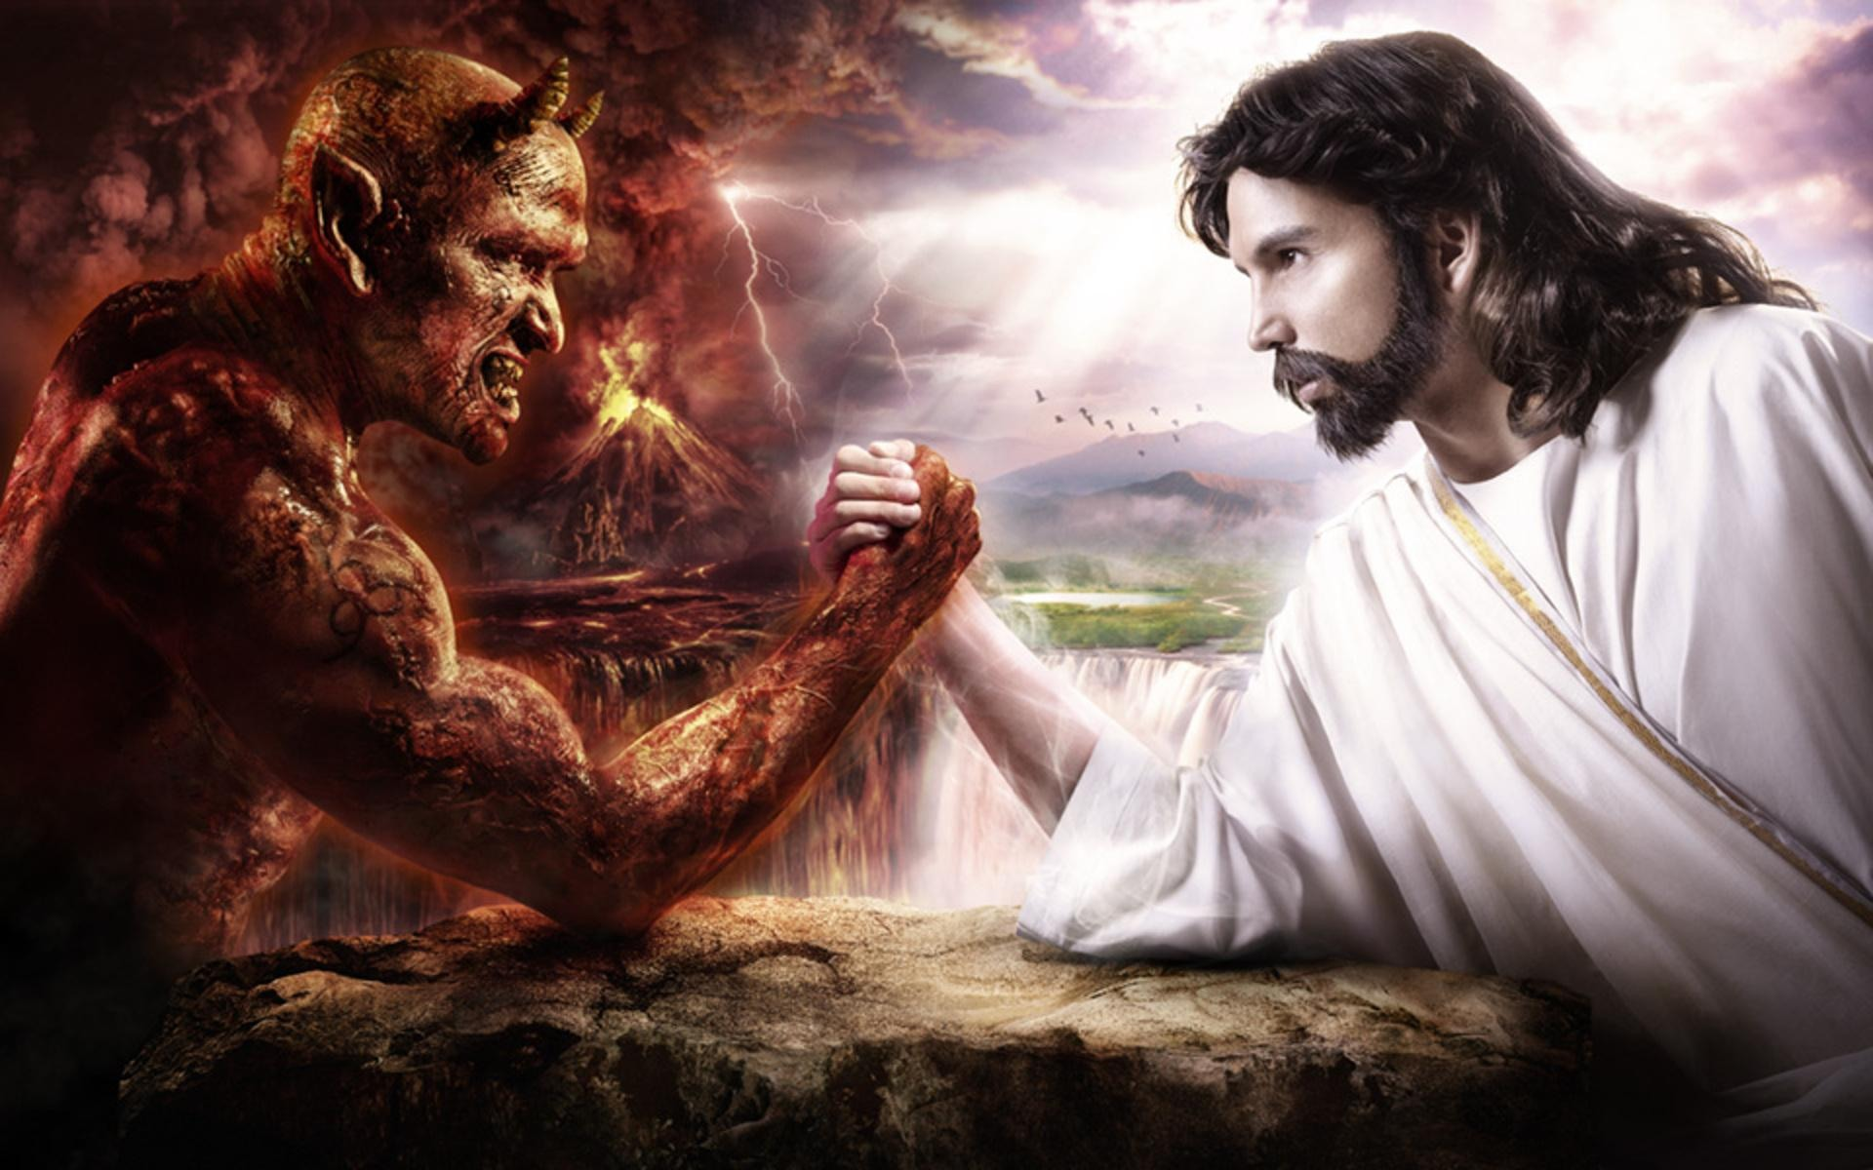
Matthew 4:1-11
Matthew 4:1-11
Notes:
Matthew 4:1-11
Then Jesus was led up by the Spirit into the wilderness to be tempted by the devil. He fasted forty days and forty nights, and afterwards he was famished. The tempter came and said to him, “If you are the Son of God, command these stones to become loaves of bread.” But he answered, “It is written, ‘One does not live by bread alone, but by every word that comes from the mouth of God.’” Then the devil took him to the holy city and placed him on the pinnacle of the temple, saying to him, “If you are the Son of God, throw yourself down; for it is written, ‘He will command his angels concerning you,’ and ‘On their hands they will bear you up, so that you will not dash your foot against a stone.’” Jesus said to him, “Again it is written, ‘Do not put the Lord your God to the test.’” Again, the devil took him to a very high mountain and showed him all the kingdoms of the world and their splendor; and he said to him, “All these I will give you, if you will fall down and worship me.” Jesus said to him, “Away with you, Satan! for it is written, ‘Worship the Lord your God, and serve only him.’” Then the devil left him, and suddenly angels came and waited on him.

Slide 4

What is Jesus doing and why?
Notes:
Let’s explore various aspects of this passage

Slide 5
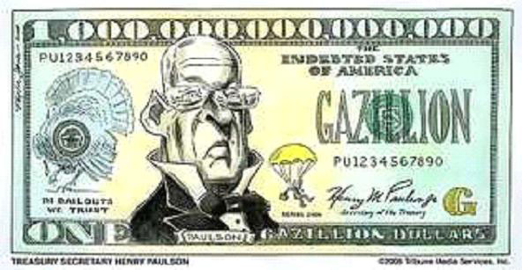
A quick word on the number 40
Notes:
The number 40 is like the number gazillion to us. It means a entity too big for us to quantify.

Slide 6
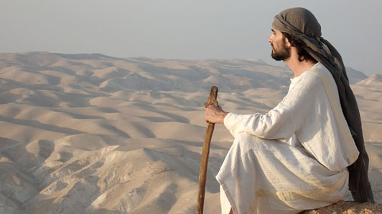
Why is Jesus in the desert?
Notes:
The desert is an actual reality in the Bible but it is also a metaphor. Growing up in the desert you might not see it the same as people who live for example in Florida. Why does the author put Jesus in the desert?

Slide 7
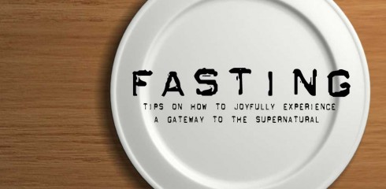
Is he trying to better himself?
Notes:
Fasting and solitude with prayer are seen as as “goods”. What is the goal of these “goods?”
Eat another marshmallow

Slide 8
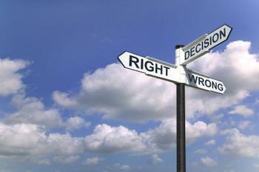
What is temptation?
Choice between 2 things
Notes:
Usually 1 short term gain and 1 long term

Slide 9

It is your choice
Notes:
Dan Ariely- In the future, we are wonderful people, we eat well, exercise, don’t text and drive.

Slide 10
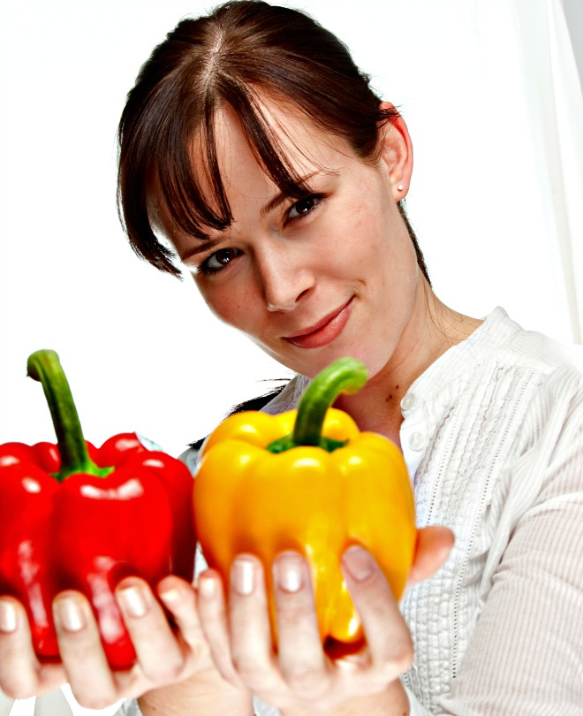
Examples
This is a choice not a tempation
Notes:
What examples can you think of? Why do people: pollute, eat bad food, act mean?

Slide 11

Is Jesus trying to acquire a long term good?
Notes:
Temptation usual is having a choice of something that is really good that is present to something that is better in the future. Why is Jesus doing this?

Slide 12
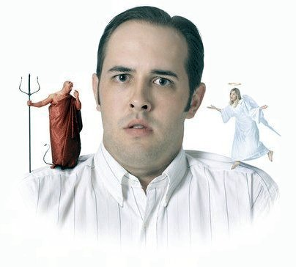
Let’s look at what the devil tempts Jesus with
Notes:
What the short term items that the devil tries?

Slide 13
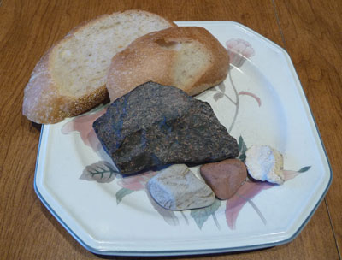
Turns stones to bread
Notes:
What does Jesus say?
What is bread a temptation here?
Eat a marshmallow

Slide 14
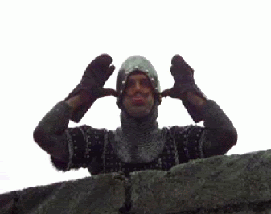
Throw yourself down from the temple
Notes:
This is really just a taunt, not temptation. If you are really cool, God will fix it.

Slide 15
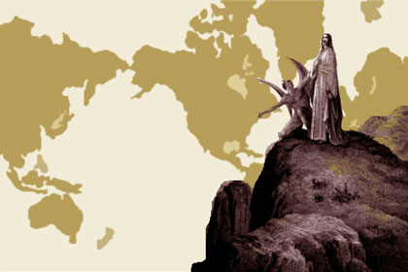
Give him all the kingdoms of the world
Notes:
Worldly Pleasure vs. After life pleasure?
What is the reward for “love of God”?
What is his response?

Slide 16

Can Science help us solve temptation?
Notes:
Now we understand what exactly temptation is , can we use Science to help us fight temptation?

Slide 17
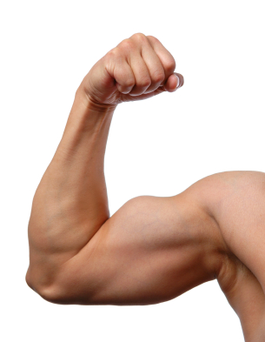
Science says…
Will power is like a muscle..
Notes:
People’s will power is like a muscle. You get tired from using it and only have so much. The best strategy is to fix environment to help you.

Slide 18
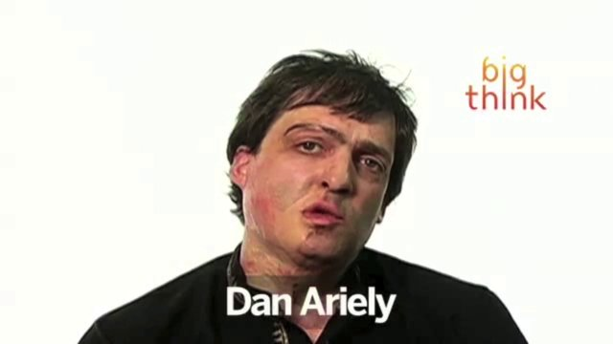
Science says…
Create rewards to keep on track
Notes:
This is Dan Ariely. Victim of massive burns and got hepatitis from blood transfusions. Had choice for liver treatment, medicine was terrible but would rid him of problem. Created a gift for himself to take his medicine, movies, which allowed him to associate the gift with taking his medicine.
Dan Ariely- Global Warming is the perfect vehicle for apathy. You get no feedback for doing good and it is a good for something way off in the future.
Eat a marshmallow

Slide 19
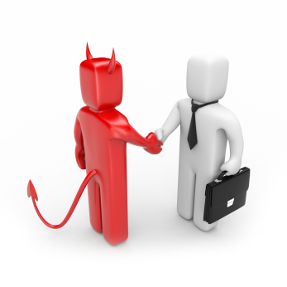
Deals with the Devil
There are lots of tales with the Devil tempting people
Damn Yankees
Devil Went Down To Georgia
Faust
Futurama- Bender in Robot Hell
Notes:
What examples can you think of?
http://en.wikipedia.org/wiki/Deals_with_the_Devil_in_popular_culture

Slide 20
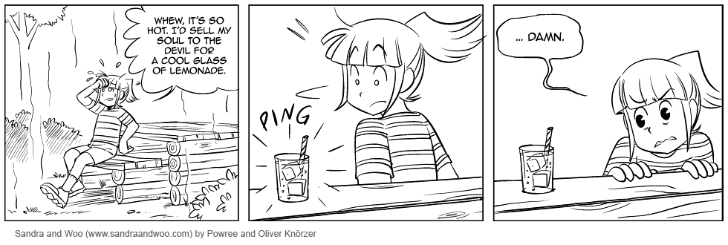
Let’s figure out our own story
What would we be trying to do?
What would tempt us away from our path?
Who would be the tempter?
Why would you not take the temptation?
What about a different spin like the temptation ends up harming the individual?
Ironic Genie
..darn

Slide 21
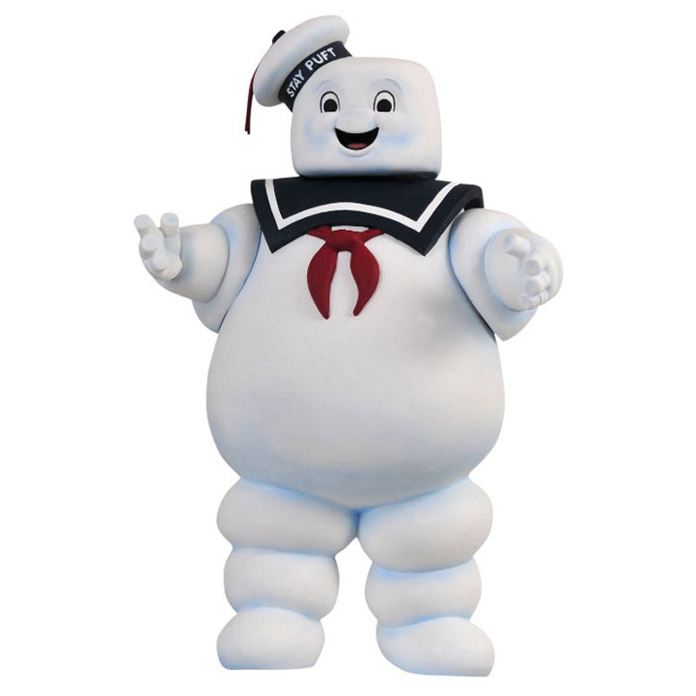
Marshmallows for everyone!
Notes:
Give out the extra marshmallows

